Slide 1




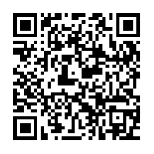

Available for all Faculty, Researchers & Students
Use the latest versions of MATLAB, Simulink, and add-on products to support your coursework and research.
Application Areas include:
Math and Statistics
Embedded Systems
Control Systems
Digital Signal Processing
Communications Systems
Image Processing and Computer Vision
FPGA Design and Codesign
The Language of
Technical Computing
Get Access: https://www.mathworks.com/academia/tah-portal/sona-college-of-technology-31285046.html

Slide 2
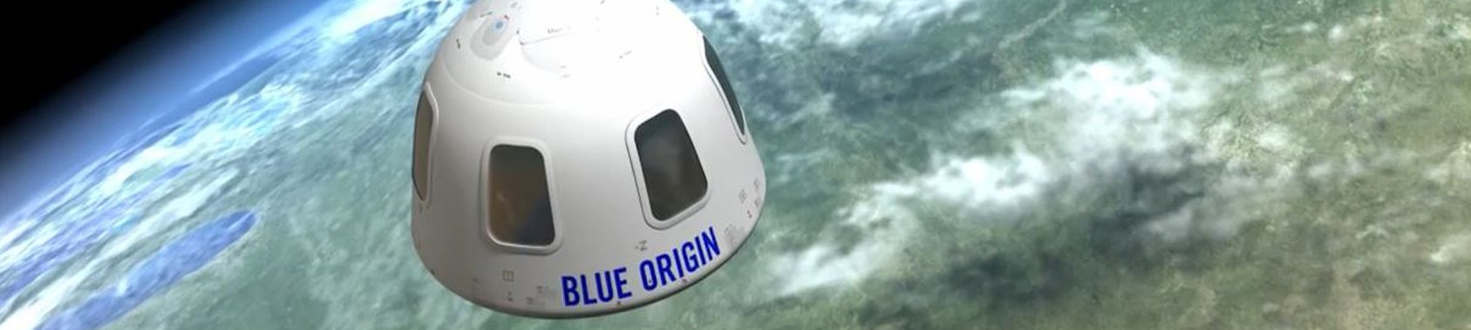




Our Customers
Millions of engineers and scientists worldwide use MATLAB and Simulink.
Why MATLAB & Simulink?
Millions of engineers and scientists worldwide use MATLAB and Simulink.
90,000+ business, government, and university sites
All of the top 10
auto manufacturers¹
All of the top 10
aerospace companies²
Three of the top five
internet companies
¹OICA: 2016 World Motor Vehicle Production
²PwC: Aerospace and Defense 2017 Year in Review
Notes:
Millions of engineers and scientists worldwide use MATLAB and Simulink
Our software is used at over 90,000 business, government, and university sites around the world
We have customers in established industries, like automotive and aerospace
The top 10 companies in each of these industries use our products
We also have customers in industries like internet services
For example, three of the top five internet companies—Amazon, Google, and Facebook—use our products for a wide range of applications
Automotive Top 10 source: 2016 International Organization of Motor Vehicle Manufacturers (OICA) world ranking of manufacturers by production
Aerospace Top 10 source: PwC Aerospace and Defense 2017 Year in Review and 2018 Forecast
Internet Top 5 source: Wikipedia list of largest Internet companies:
https://en.wikipedia.org/wiki/List_of_largest_Internet_companies

Slide 3


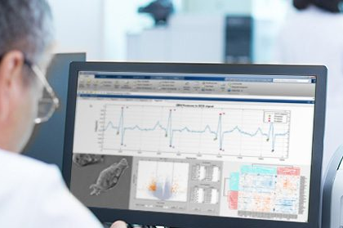

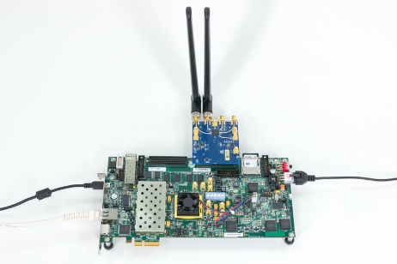
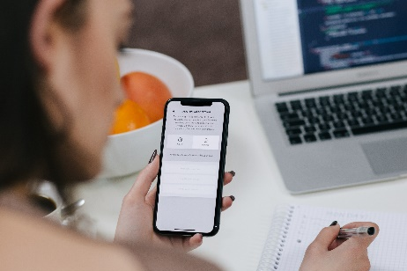
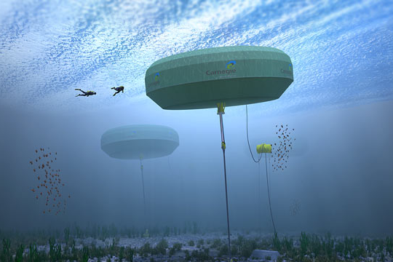
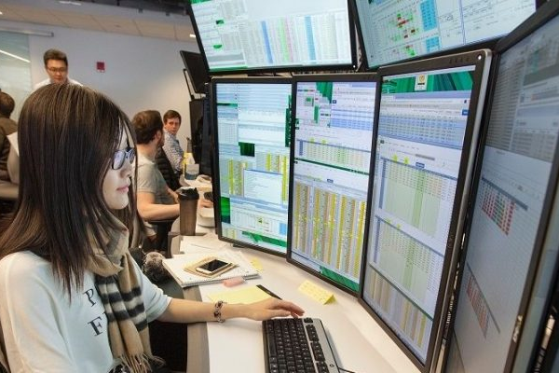

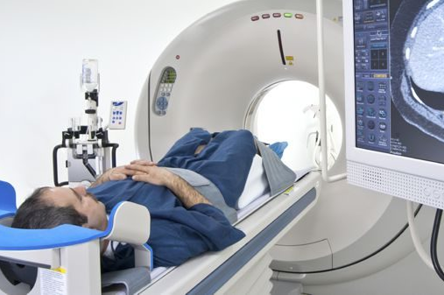

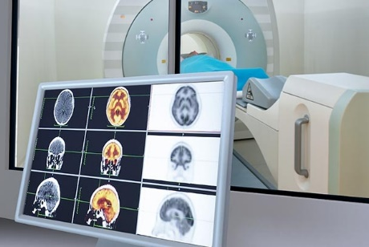
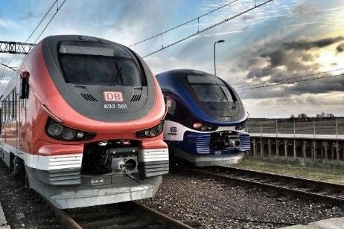

Key Industries
Aerospace and Defense | Automotive | Biological Sciences | Biotech and Pharmaceutical | Communications
Electronics | Energy Production | Financial Services | Industrial Machinery | Medical Devices
Metals, Materials, Mining | Neuroscience | Railway Systems | Semiconductors | Software and Internet
Notes:
All told, our software is used in over 20 industries, from aerospace and automotive, to biotech, energy production, financial services, medical devices, and railway systems.
Now let’s see a few of the ways our customers and our products are changing the world

Slide 4
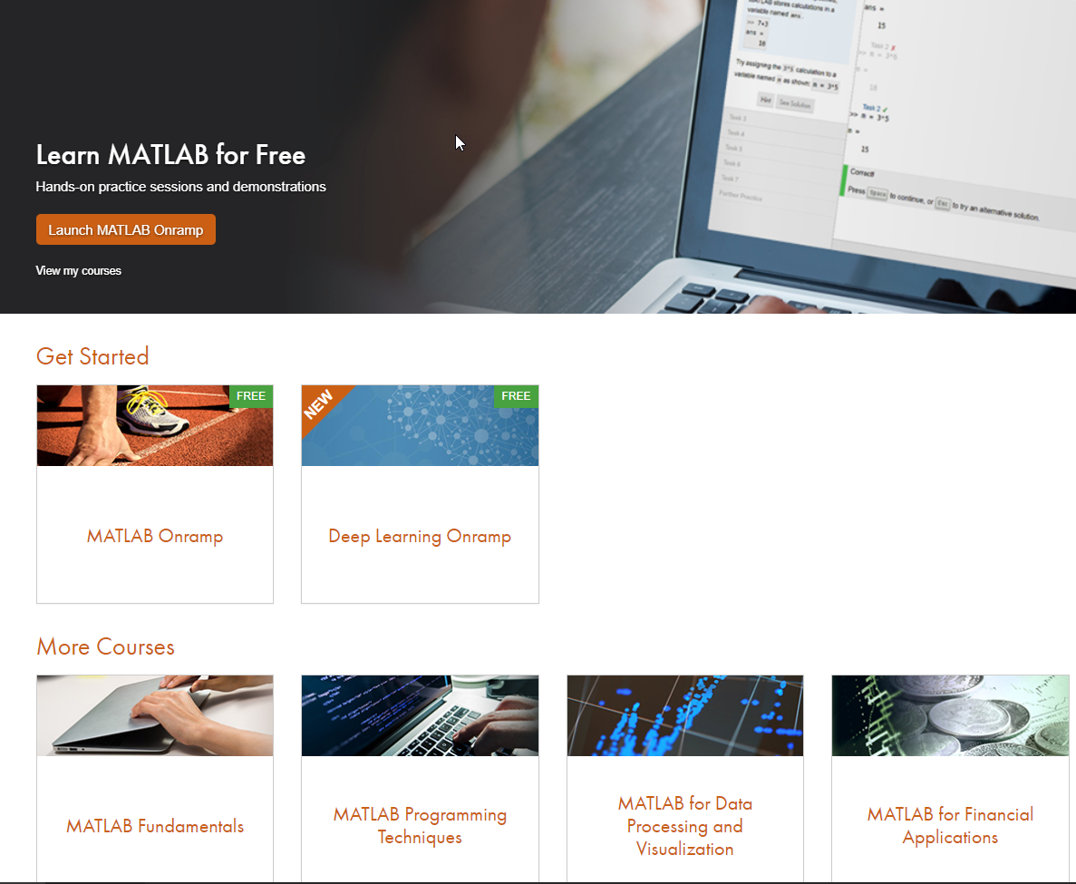
Interactive, Self-Paced Courses
Online Self-Paced MATLAB Courses
  Easy access from anywhere
  Built-in integration with MATLAB Online
  On-demand
Task Oriented Lessons
  Best practices and typical workflows
  Short illustrative videos
  Interactive pages
  Hands-on exercises with feedback
matlabacademy.mathworks.com

Slide 5




MATLAB Anytime Anywhere- Access these services from: https://www.mathworks.com/academia/tah-portal/sona-college-of-technology-31285046.html
MATLAB Online
MATLAB Drive
Desktop
MATLAB Mobile
Notes:
Who here has used MATLAB before? Who here does computation?
You are familiar with the desktop MATLAB, now you can access MATLAB online within a web browser, or on your phone and tablet through MATLAB Mobile. Your files are all synced on MATLAB Drive, so you can access them anytime across multiple devices. After all, students (and professors) are used to watching Netflix anytime anywhere expecting the program to automatically pick up where you left off. We should expect the same convenience with technology in the classroom too.

Slide 6
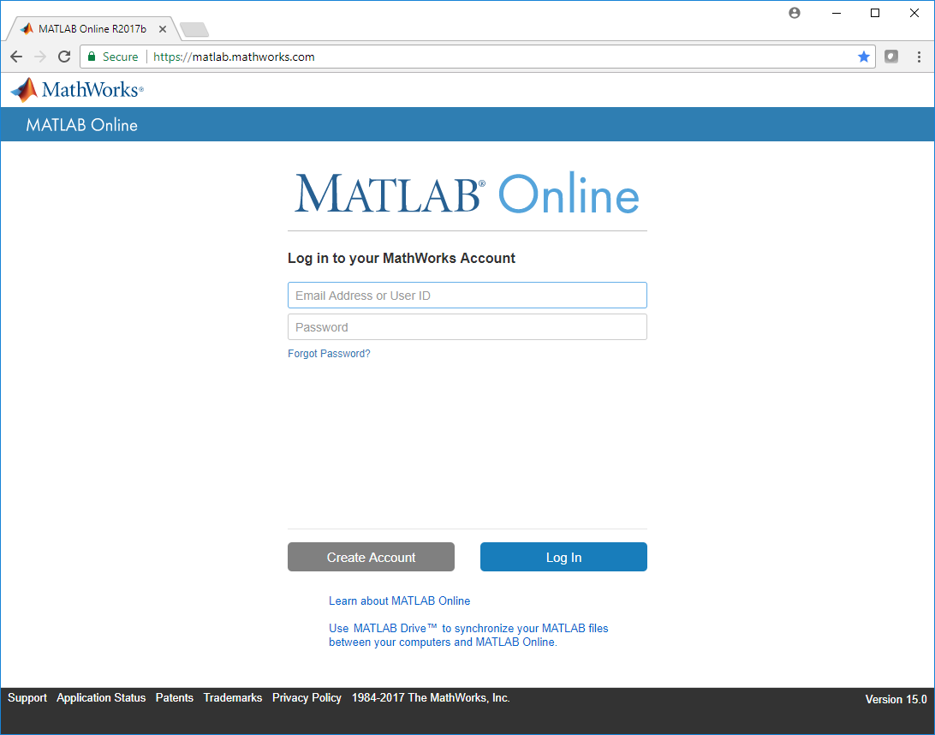
MATLAB Online - Use MATLAB through Your Browser
No downloads
No setup
No installation
No maintenance
Just sign in at
matlab.mathworks.com or your University MATLAB Portal
Use it anywhere, anytime, on any computer, laptop or Chromebook

Slide 7

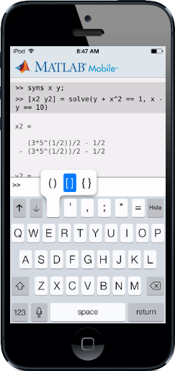
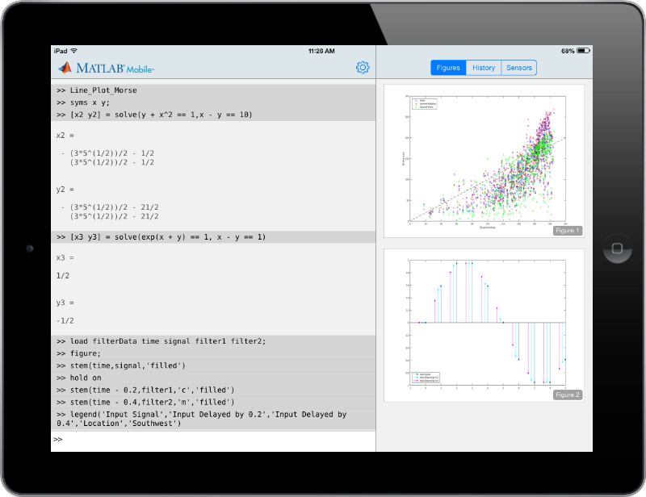
MATLAB Mobile-Available for your iPhone, iPad, or Android device (Sign-in with your account)
Notes:
Such as your phone or tablet using ML Mobile. MATLAB Mobile allows you to use your smartphone for running basic MATLAB commands and interact with MATLAB Desktop and Drive. It also allows access to raw data from your smartphone sensors that can be leveraged for various applications. This brings us to the notion of project-based learning.
DEMO: Demo the step-counter portion of Mobile devices demo.

